Slide 1
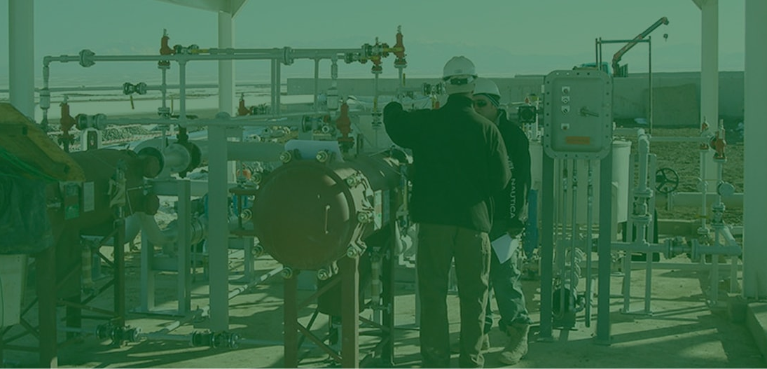


Slide 2
Telemetry and Process Controls, Inc. is continuing James Edison Seniors’ mission of providing reliable, quality process control automation system solutions. Since 1974, we have been committed to becoming the single-source leader in the custom control industry. Our experience and knowledge in custom controls allows us to provide the customer the proper solution, regardless of the complexity of the customer's needs. Our customer base is worldwide, structuring us for the highest quality of solutions and service. We are proud of our technical depth and commitment to provide quality, service, and value to our customers.

Slide 3

COMPANY OVERVIEW
Founded in 1974 by James Edison Senior
Located in Oakdale MN (30 minutes East of MSP International Airport)
We are housed in a 32,000 sqft. building with 20,000 sqft. dedicated to production.
91 Employees Covering a Variety of Disciplines:
  Engineering
  Software
  Field Service
  Wiring Technicians
  Quality Control
We serve our customers globally with TPC projects landing on nearly every continent
  From Birmingham to Bahrain, and nearly everywhere our customers needs may take us

Slide 4

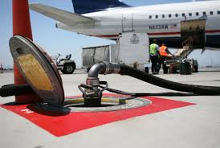
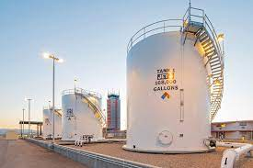
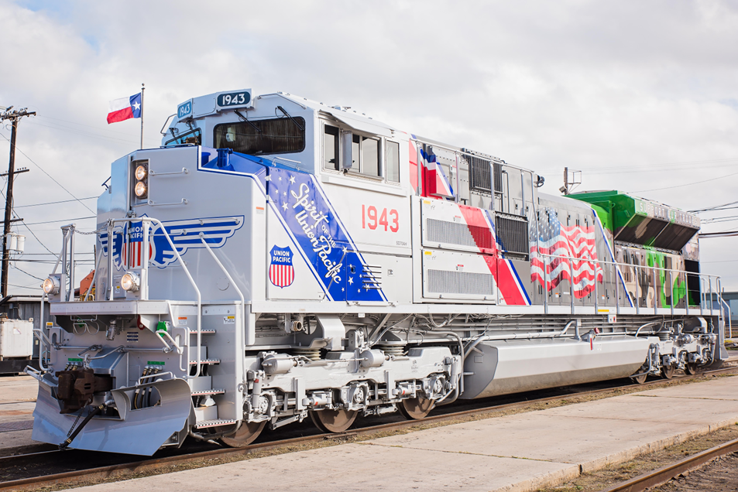
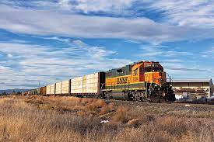
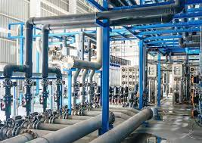
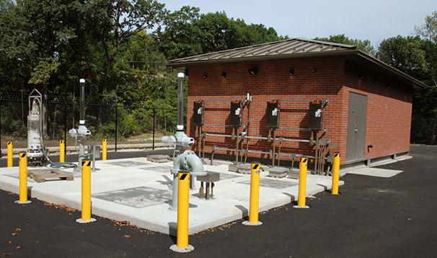
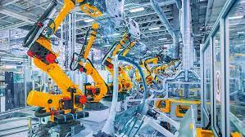
Industries Served
Department of Defense
Commercial Fueling
Railway
Industrial Water / Wastewater
Industrial OEM

Slide 5

















Customers We Serve

Slide 6
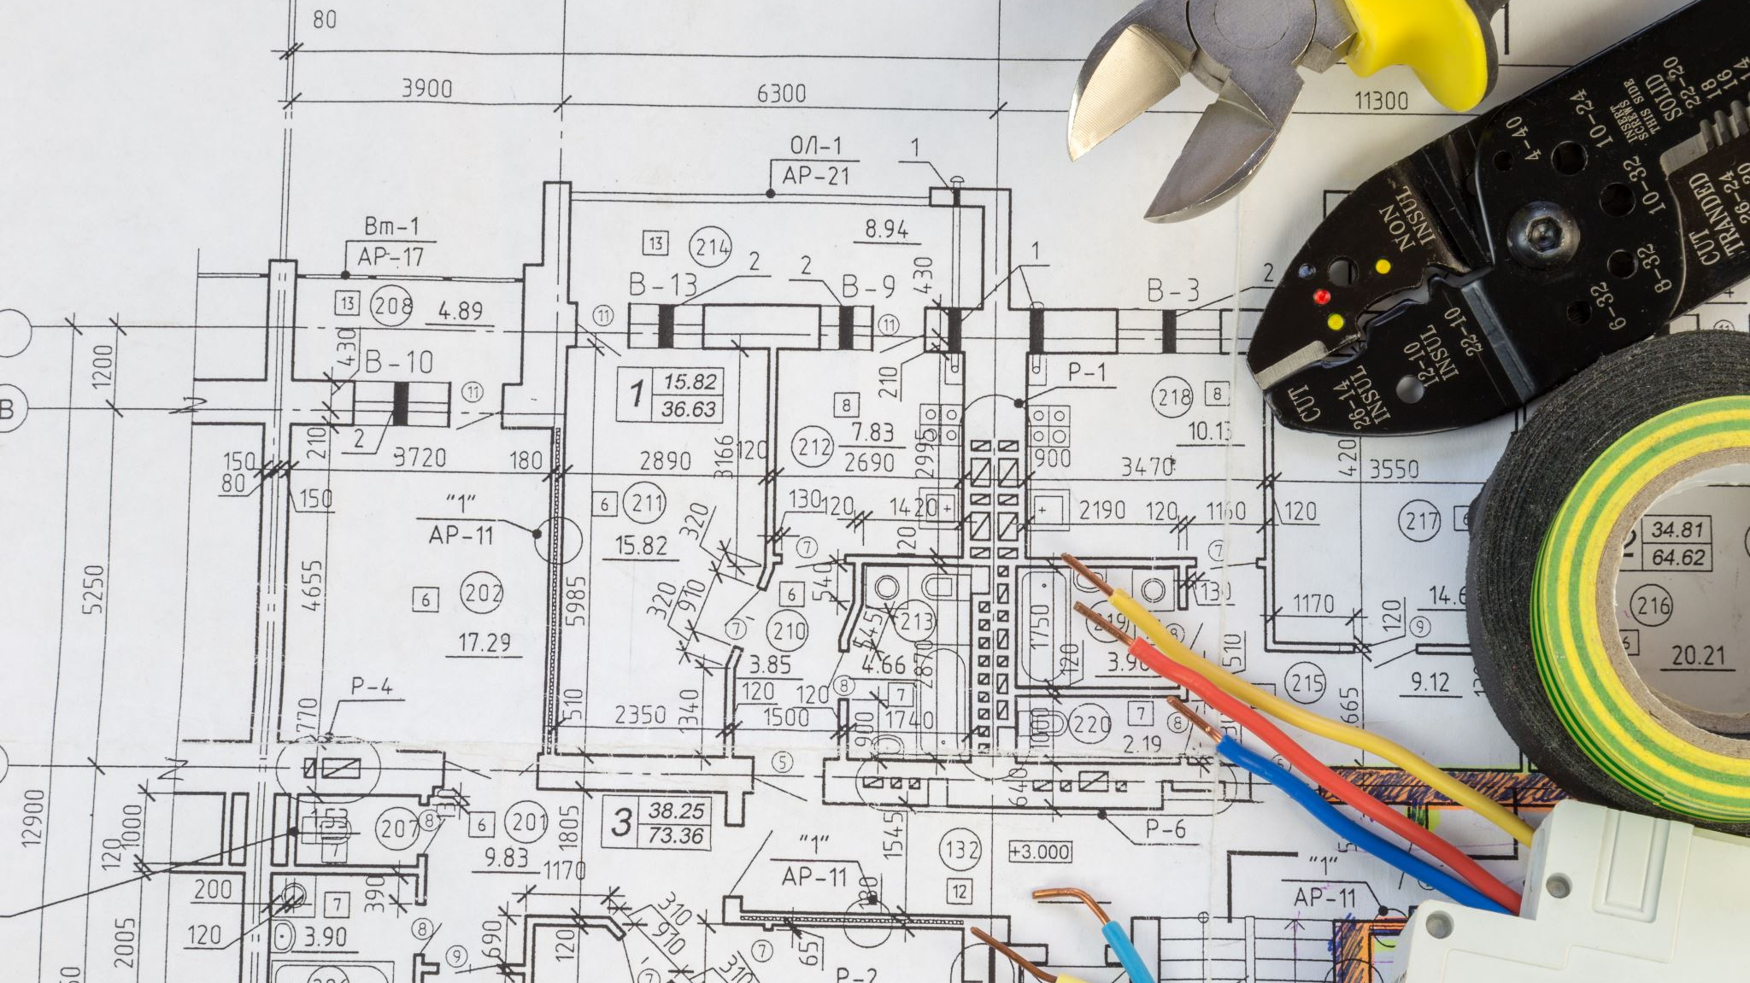

Engineering Services

Slide 7
Engineering
12 Full Time Electrical & Controls Engineers
TPC is Certified UL508a / 698 Hazardous Location / 698a Intrinsic Safety
Offering Full Design & Project Specification
Utilizing AutoCAD Electrical & Solid Modeling
Providing Bid Specification, Construction & Design Approvals, Customer Submittals
Serving the Customers with Design Support & On-Site Engineering Surveys
Capable of providing other NRTL Certifications
Specializing in Custom Control Retrofit

Slide 8
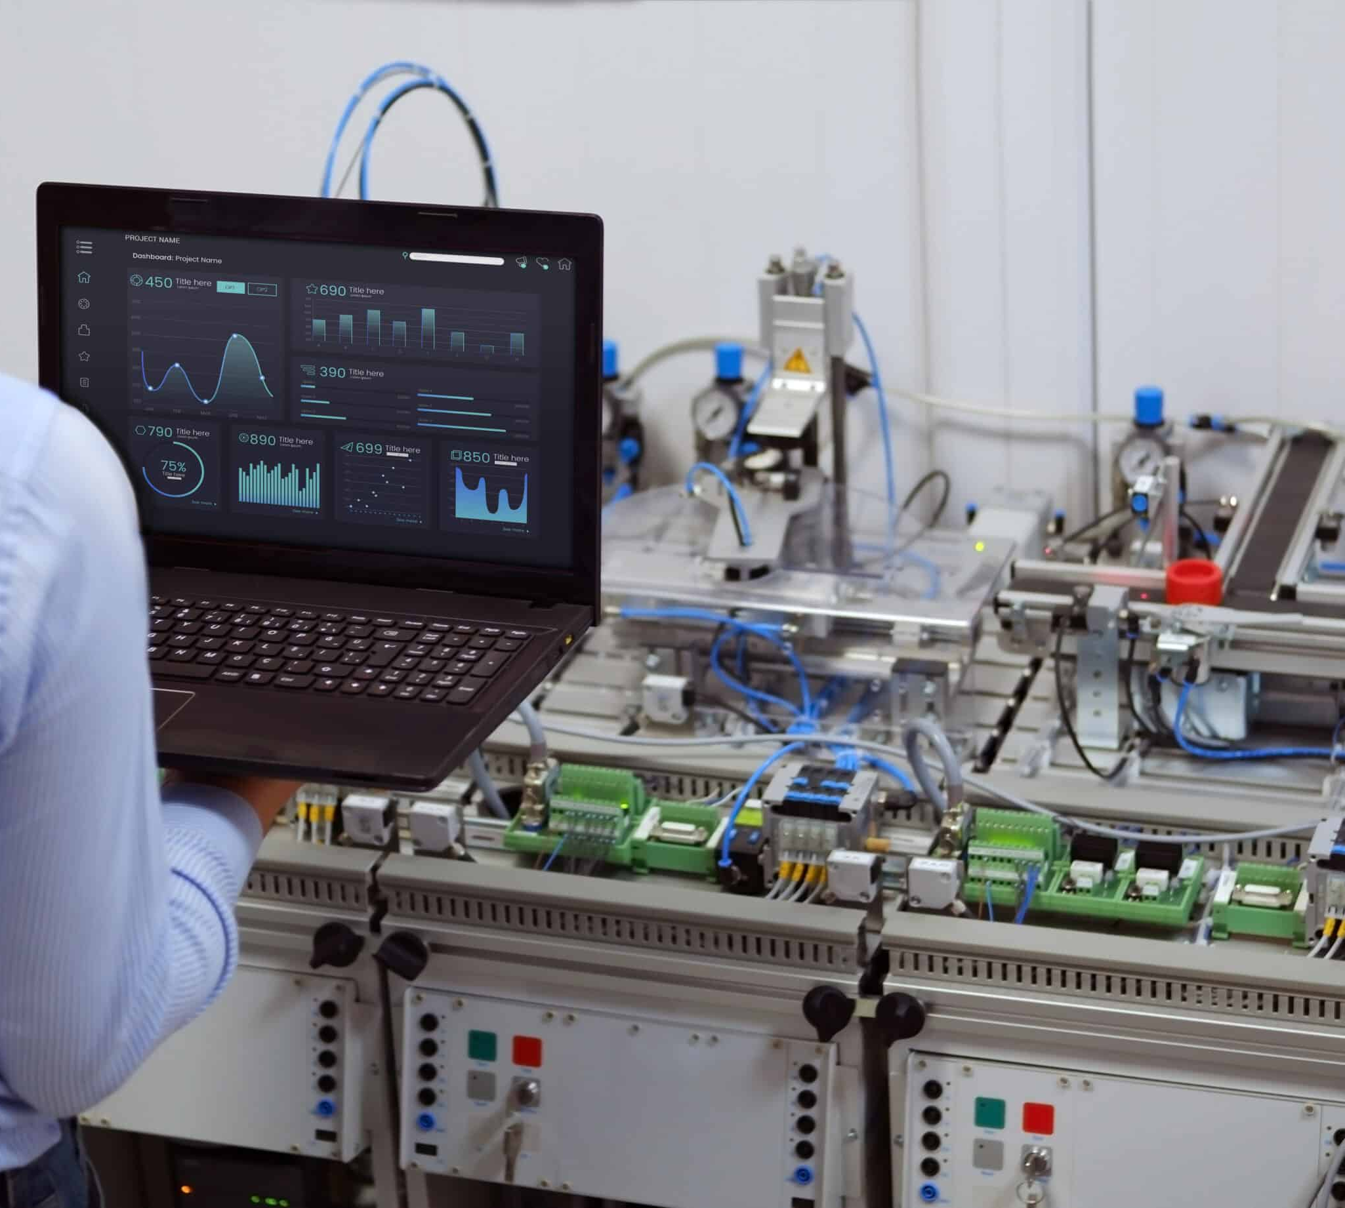

Software Programming

Slide 9
Software
10 Full Time Software Programmers
Certified Allen Bradley / Rockwell Solutions Provider
Certified Inductive Automation Ignition SCADA Provider
Brand Agnostic with Working Experience in nearly all Brand Platforms
Advising on Appropriate Solutions for Customer Needs
Providing SCADA, PLC, IPC, & HMI/OIT Software Development
Capable or Regulatory Software Reporting Services
Specializing in Code Redesign & Redeployment
Serving our Customers with On-Site Application Support

Slide 10

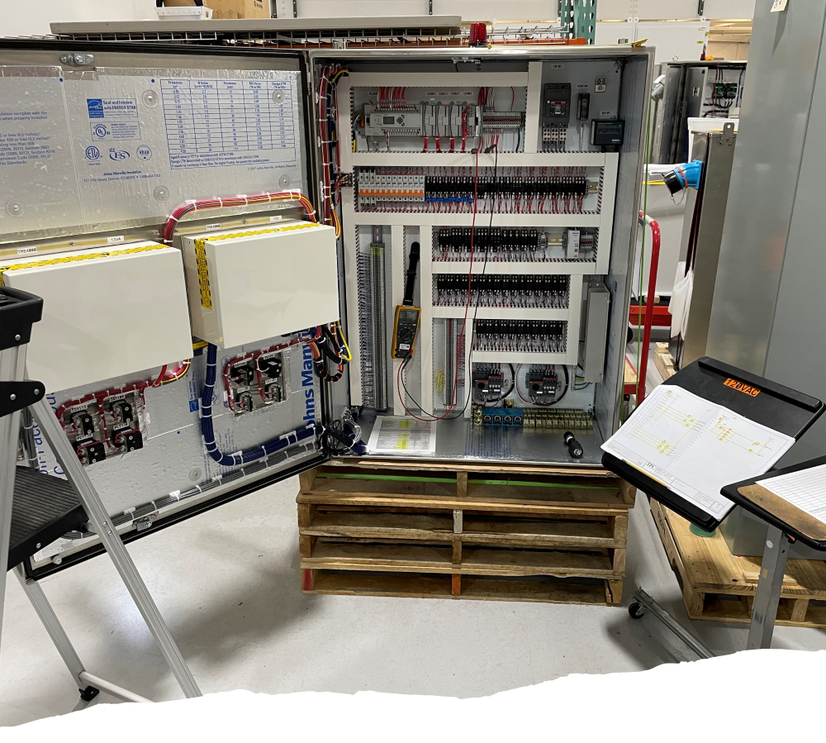
Control Panel Assembly

Slide 11
Control Panel Assembly
24 Full Time Wiring Technicians
6 Quality Control Technicians
Panels Built to TPC Design, Build, & Quality Standards
Ability to List Customer Builds to UL, ETL, & Other NRTL Certifications
Providing Build to Print & Design Services for our Customers
Specialized Enclosure Machining & Assembly Operations
Quality Procedures include Standard Point to Point & Full Functional Testing
Customer Factory & Site Acceptance Testing Offered

Slide 12
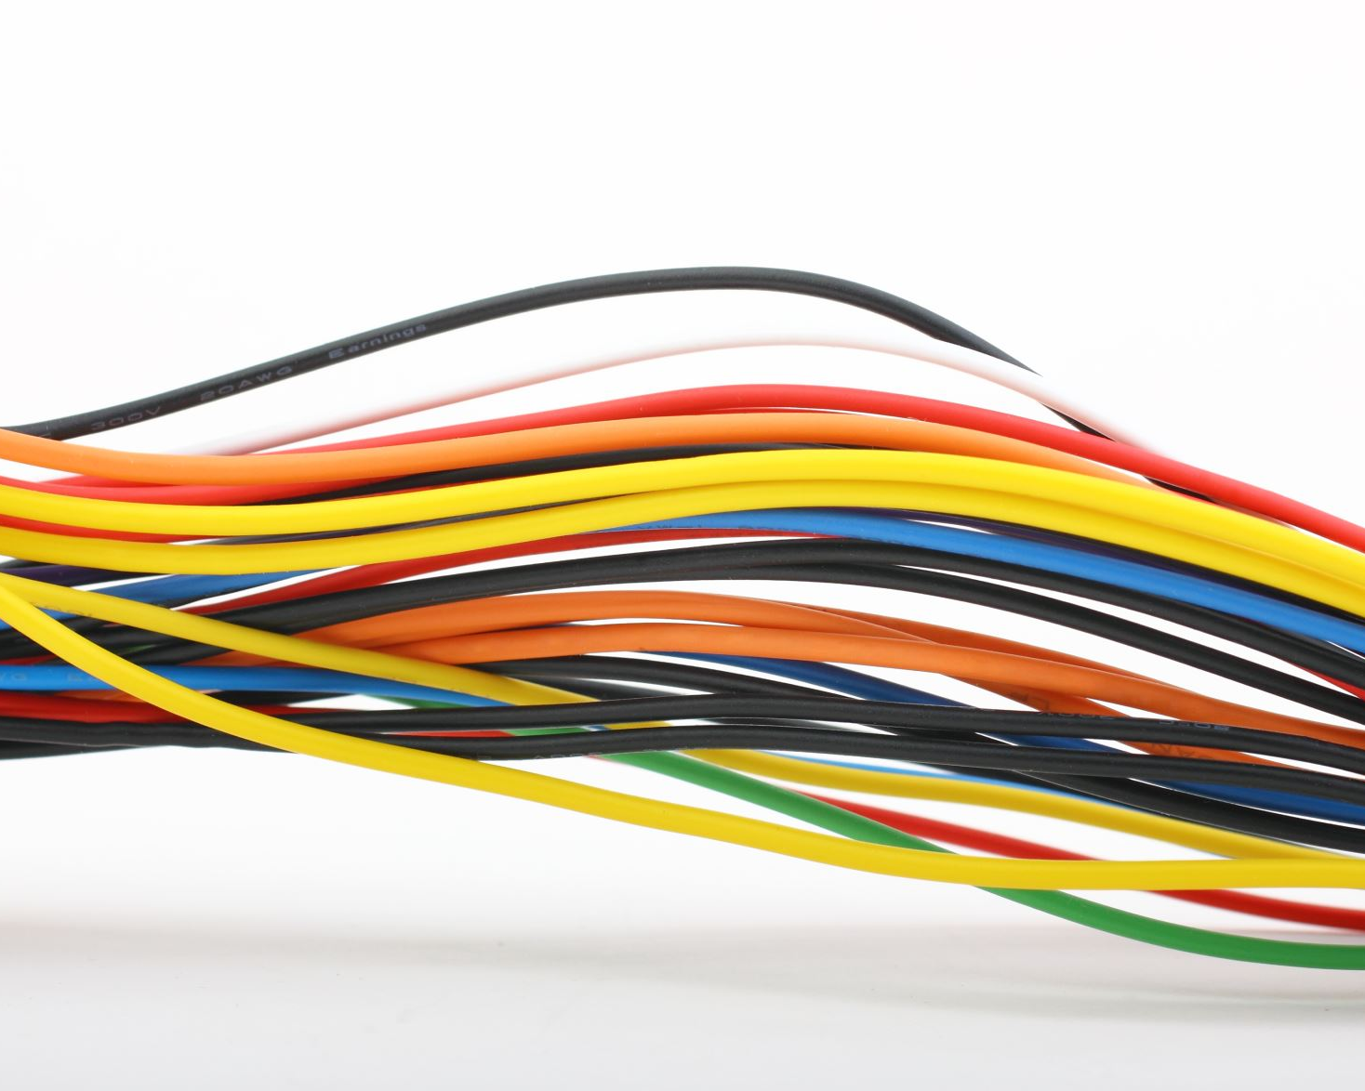
Custom Cable Assembly

Slide 13
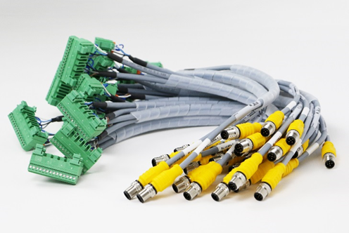
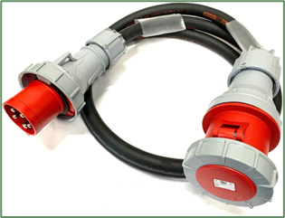
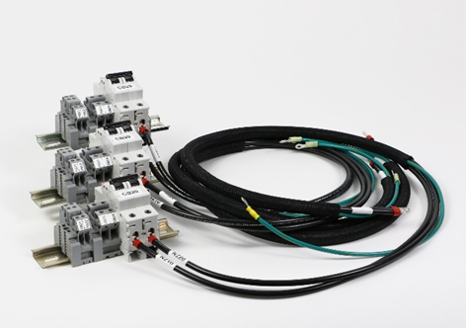
Custom Cable Assembly
TPC is able to provide Custom Designs as well as Customer Build to Print
Capable of Producing OEM Quantities
TPC Engineered Designs
Power, Signal, IO, and Custom Connectivity

Slide 14

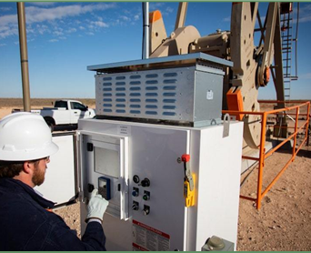
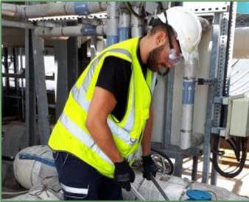
Field Service

Slide 15
Field Service
TPC Provides General Systems & Device Troubleshooting
We are able to perform On-Site Controls Installation & Wire Termination
Our Technicians Travel with our Systems for Device Commissioning
Ability to Provide Field Programming Updates & Edits
Maintenance, Calibration, and Field Replacement of Process Instrumentation
Providing Radio & Telemetry Services
System & Site Preventive Maintenance
Laser Alignments of Motors and Critical Devices

Slide 16
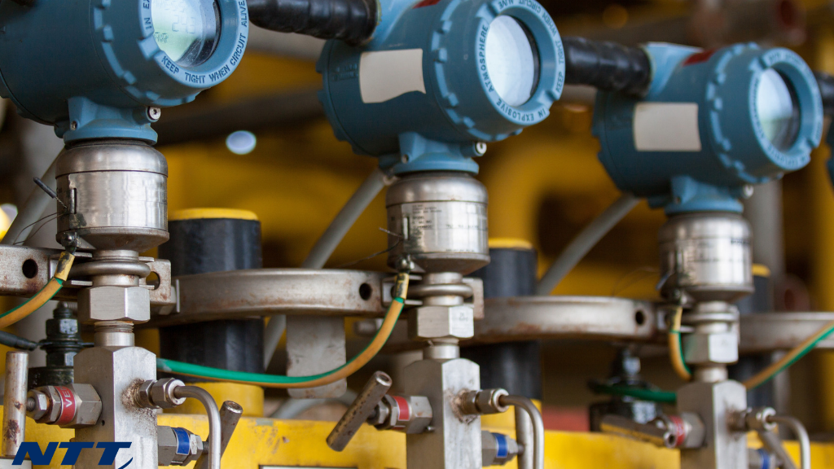
Process Control & Integration

Slide 17
Process Control & Integration
Control Systems and field devices no longer live on islands
Customers utilizing connectivity to bring field data to SCADA and ERP Systems
TPC specializing in providing custom solutions to connect, monitor, & report data
Equipment monitoring solutions to provide maintenance alerts
Cellular data solutions to connect remote instruments to the world
Analysis tools to monitor motors for heat and vibration
Connecting process instruments with analytics and data reporting software
Solutions for monitoring, measuring, and capturing data are endless

Slide 18
Questions…

